Slide 1

in the bed(in bed)
VS on the bed(on bed)

Slide 2

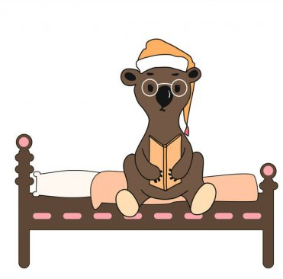
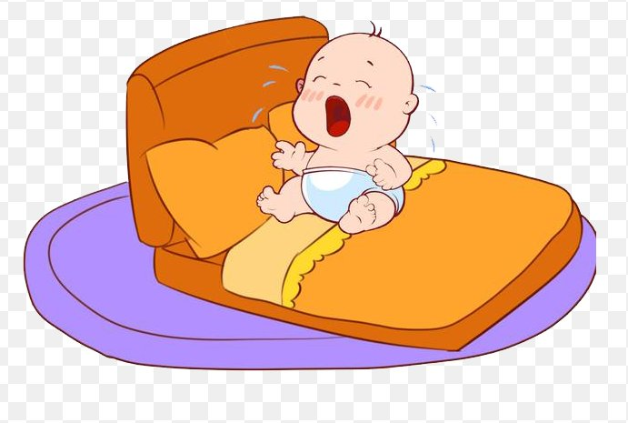
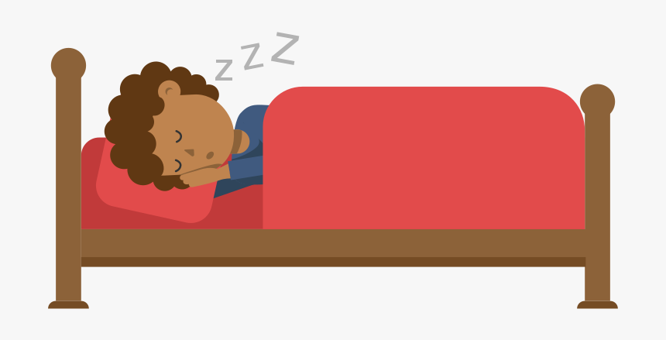
Sleeping in the bed would actually mean to be inside the bed(covered by under the sheets") .
Sleeping on the bed logically mean laying on the bed on the surface of it.
in the bed(in bed)
on the bed(on bed)

Slide 3

Clifford the big red dog
相關資訊補充

Slide 4
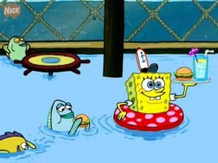
SpongeBob is in the swimming pool.

Slide 5

Security guard Josh is next to Karen..
Karen
Phobe
Denny
Josh
John

Slide 6
The end

